Slide 1
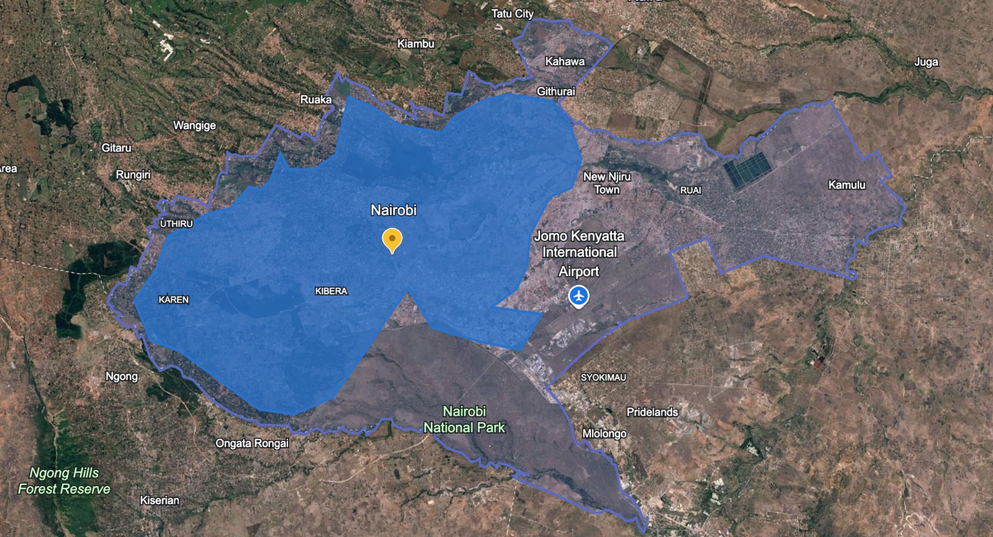
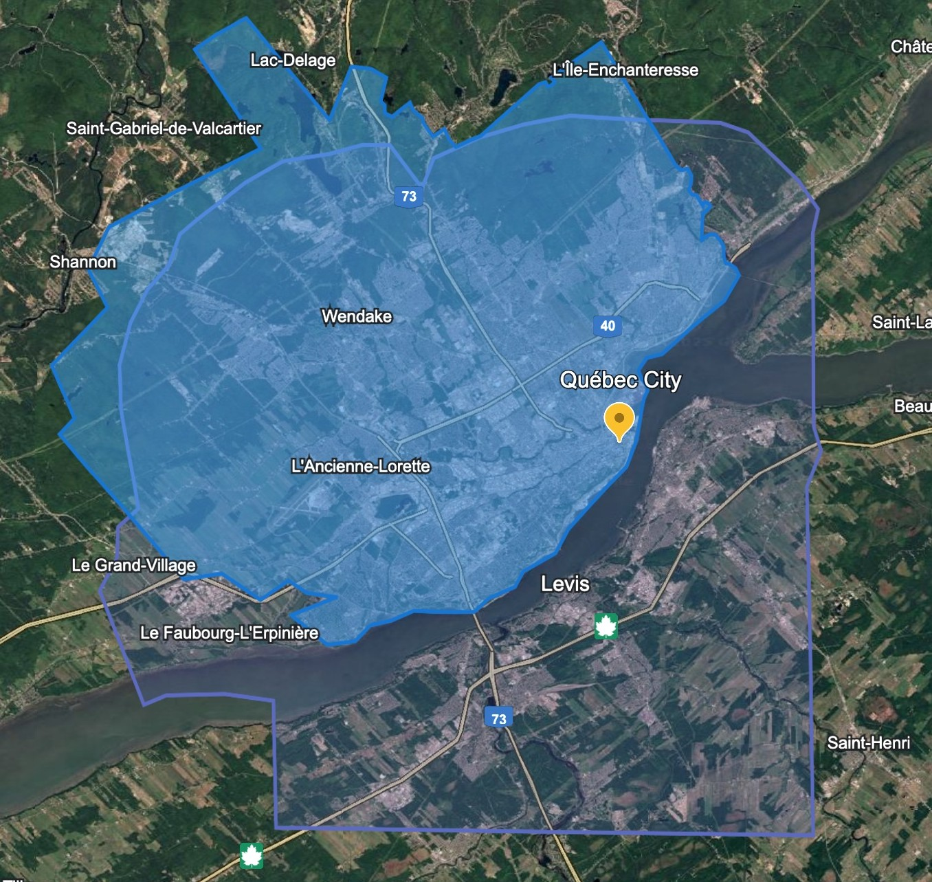
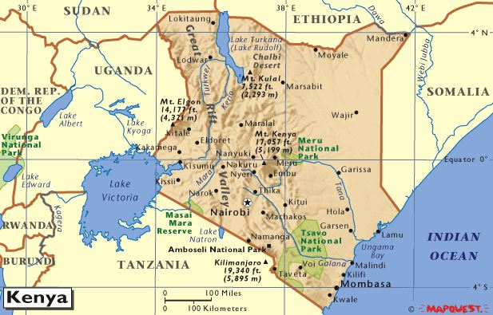
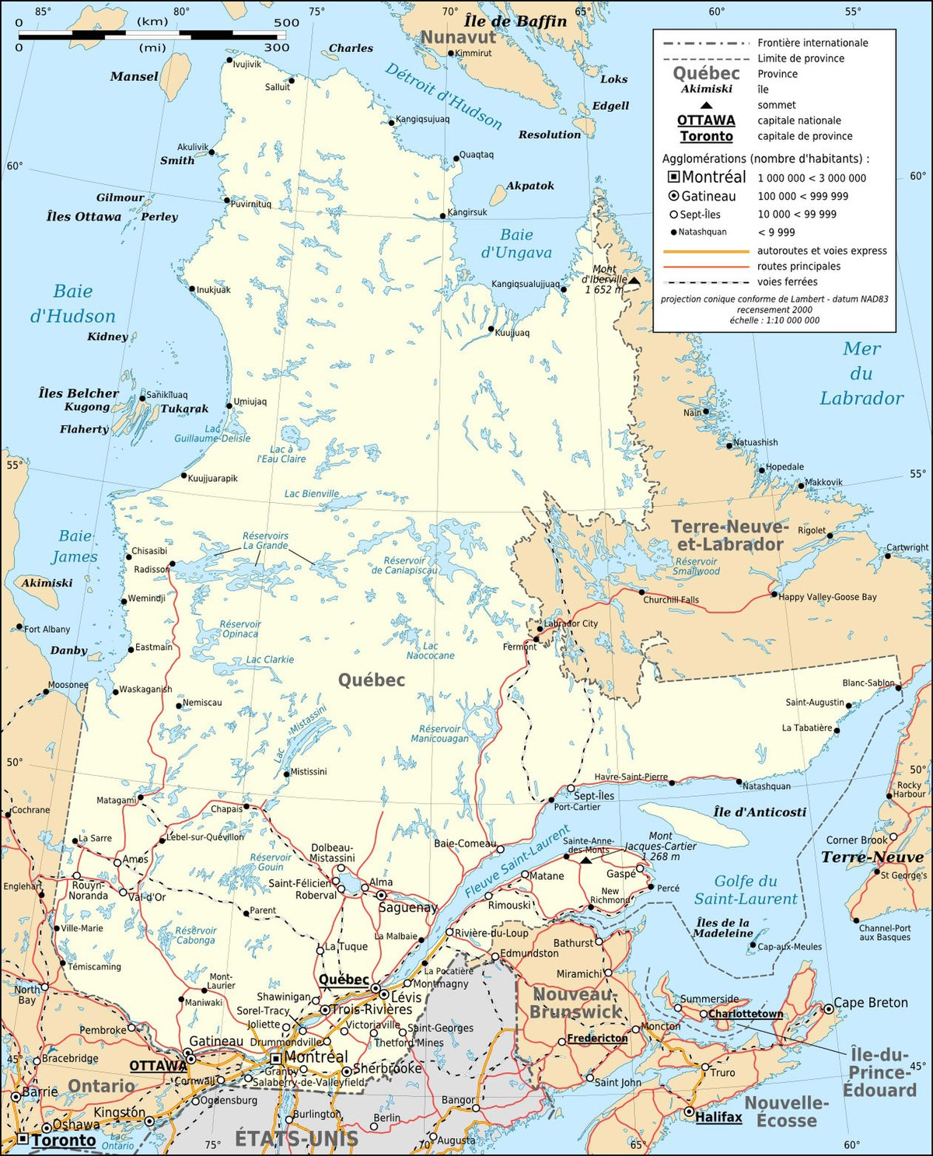
Comparing Land-Use Change Between Canadian and African Cities
Krishna Priya Malladi, Darshan Bugaliya
GEOG 1010-1, Thompson Rivers University
ABSTRACT
METHODS
RESULTS
DISCUSSION
This project examines how land use has changed in Québec City, Canada and Nairobi, Kenya since the 1980s. Using Google Earth historical imagery, we compared growth on the urban fringes and changes in the downtown cores. We also related these changes to human geographic processes such as suburbanization, urbanization, and rural-to-urban migration. Our findings show that both cities expanded outward, but Québec City grew mainly through planned suburban housing, while Nairobi expanded rapidly with both formal and informal settlements. In the downtown areas, both cities redeveloped older buildings, though Nairobi experienced faster vertical growth. Overall, the differences reflect broader patterns between cities in the Global North and Global South.
We used Google Earth Historical Imagery to examine land use from the 1980s to 2024.
We looked at two main areas in each city:
Urban Fringe (where rural land becomes urban)
Downtown Core (using 3D mode to observe taller buildings)
We compared visible changes such as:
Expansion of housing
Creation of new roads
Growth of commercial or industrial areas
Redevelopment or replacement of older buildings
A short literature review helped link the changes to processes such as urbanization and suburbanization.
1. Québec City
Urban Fringe
Major growth in single-detached suburban neighborhoods.
Expansion of planned subdivisions, new roads, and shopping areas.
Farmland around the edges was gradually replaced with housing.
Growth is organized, low-density, and car-dependent.
Downtown Core
Increase in mid-rise and high-rise buildings.
Redevelopment of older commercial structures.
Heritage areas preserved but surrounded by new construction.
Growth is regulated and follows urban planning rules.
2. Nairobi
Urban Fringe
Very fast expansion of housing since the 1980s.
Growth includes formal housing and informal settlements.
Agricultural land converted to dense residential areas.
Infrastructure (roads, drainage) often expands more slowly than population.
Downtown Core
Rapid increase in tall commercial buildings.
Many older buildings replaced with modern high-rises.
Clear signs of economic concentration in the CBD.
Redevelopment happens quickly but not always evenly across the city.
Québec City reflects Global North processes:
Suburbanization driven by car ownership, zoning, and controlled growth.
Fringe growth is planned and mostly low-density.
Downtown development is moderate and regulated.
Nairobi reflects Global South processes:
Rapid urbanization and rural-to-urban migration.
Fringe growth includes many informal settlements due to housing shortages.
Downtown growth is faster and more vertical than Québec City.
Both cities grew outward and upward, but the speed, density, and level of planning differ significantly.
Differences clearly align with patterns between the Global North (slower, planned, regulated) and Global South (faster, less regulated, migration-driven).
INTRODUCTION
Cities change over time because of processes such as suburbanization, population growth, migration, and urban redevelopment. One way to understand these changes is by looking at land-use patterns using tools like Google Earth.
This project compares land-use change in:
Québec City, Canada — Global North
Nairobi, Kenya — Global South
Main Questions:
How have land uses changed on the edges/fringes of each city since the 1980s?
How have land uses changed in the downtown cores?
How do these changes reflect different human geographic processes in the Global North vs. Global South?
CONCLUSION
Land-use change in Québec City and Nairobi shows how geography, planning, and social processes shape cities differently. Québec City demonstrates controlled suburban expansion with strong planning, while Nairobi shows rapid, mixed formal and informal growth driven by migration and population increase. Downtown areas in both cities have redeveloped, but Nairobi has experienced more rapid vertical growth. Google Earth imagery proved to be a useful tool for identifying these patterns and connecting them to human geographic concepts studied in class.
Nairobi, Kenya
REFERENCES
Statistics Canada. (n.d.). Population and urban development data for Québec City. Government of Canada. https://www.statcan.gc.ca/
Ville de Québec. (n.d.). Urban planning and development documents. https://www.ville.quebec.qc.ca/
Mercier, M. (2024). Human geography (11th ed.). Oxford University Press.Google. (1984–2024). Google Earth Pro [Software]. https://www.google.com/earth/
Ong’ondo, Frank Juma, et al. “Monitoring and Prediction of Land Use and Land Cover Using Remote Sensing and CA-ANN.” Rangeland Ecology & Management, vol. 102, Sept. 2025, pp. 160–171, https://doi.org/10.1016/j.rama.2025.06.015. Accessed 23 Aug. 2025.
NAIROBI CITY COUNTY. (2023). NAIROBI CITY COUNTY COUNTY INTEGRATED DEVELOPMENT PLAN 2023 - 2027. https://nairobiassembly.go.ke/ncca/wp-content/uploads/paperlaid/2023/NAIROBI-CITY-COUNTY-INTEGRATED-DEVELOPMENT-PLAN-FOR-2023-2027-1.pdf
This Photo by Unknown Author is licensed under CC BY-NC-ND
This Photo by Unknown Author is licensed under CC BY-SA
Quebec City, Canada

